Slide 1
CREDIT CARD FRAUD DETECTION
CAPSTONE PROJECT INTERIM PRESENTATION
Team Members
Dhanesh K
Manoj Kumaran R
Sudveep Kumar Reddy
Anirudh Ramachandra
Nagaraju Arveti
Venkatramana S
Mentor
Ms. Anjana Agrawal

Slide 2
Business understanding
As online transactions increased over a period of time online fraud also subsequently increased.
Although the proportion of fraud to nonfraud transactions is very low the chances of online fraud to grow is increasing gradually.
The goal is to identify and reduce the online fraud transactions without disturbing the flow of legal transactions.
By reducing the number of frauds, this will increase the trust of the customers in approaching the bank for the future.

Slide 3
problem statement
Credit card frauds are increasing heavily because of fraud financial loss is increasing drastically.
There has been a growing amount of financial losses due to credit card frauds as the usage of the credit cards become more and more common.
For the fraud detection problem, although the typical prediction modeling performance measures are quite relevant, as indicated by the bank authority, a performance criterion, measuring the loss that can be saved on the cards whose transactions are identified as fraud is more prominent
As a result, what we are facing is a classification problem with variable misclassification costs.

Slide 4
Data understanding
The dataset contains 284807 number of rows and 31 number of columns.
There is no categorical columns present in the dataset as it contains only numerical columns.
The columns are 'Time', 'V1', 'V2', 'V3', 'V4', 'V5', 'V6', 'V7', 'V8', 'V9', 'V10', 'V11', 'V12', 'V13', 'V14', 'V15', 'V16', 'V17', 'V18', 'V19', 'V20', 'V21', 'V22', 'V23', 'V24', 'V25', 'V26', 'V27', 'V28', 'Amount', 'Class‘.

Slide 5
Why pca ?
The columns V1 to V28 is a result of PCA.
These columns may actually contain personal details of the customer which the bank doesn’t want to reveal.
So the bank used a Principal Component Analysis on the data to protect its customers’ details.
As a result of the PCA multicollinearity is reduced.

Slide 6
Steps for further process
Data preparation
Data Imbalance process
EDA
Scaling the data
Significant variables
Model Building

Slide 7
Data preparation
There are no missing values present in the data.
Also there is no categorical feature present in the data.
For outlier treatment, it cannot be performed because the PCA values are mostly zero’s and negative so the identification of real outliers is not possible.
By using the box plot, it shows the extreme values and if we use the IQR capping method we will have a huge loss of data and hence no transformation technique was used.
Transformation techniques like log, square-root, exponential, Box-Cox won't work because of the values that are very close to zero and negative values as well.
So, it’s better not to use the outlier treatment for this data.

Slide 8
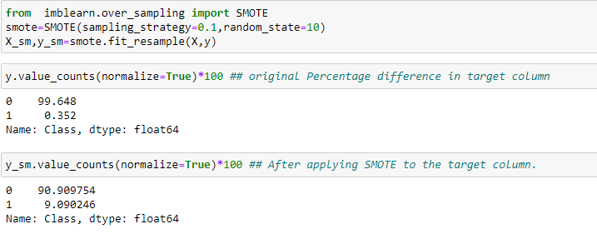
Data imbalance process
The data is highly imbalanced, as number of 0's(not fraud) is 99.7% whereas for 1(fraud) it is 0.352%.
Since the value of 1's is too small it is better to go with oversampling.
So the SMOTE technique is used for the oversampling process.

Slide 9
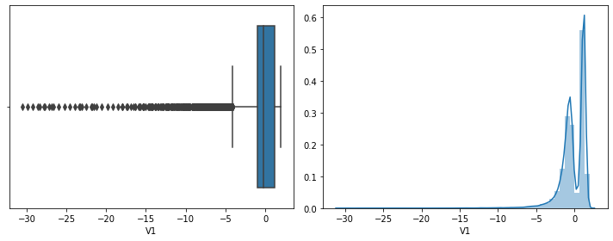
EDA – Univariate analysis
In the box plot, we could see that the V1 column has a lot of extreme values.
In the distribution plot, it shows that the V1 column is left skewed.

Slide 10
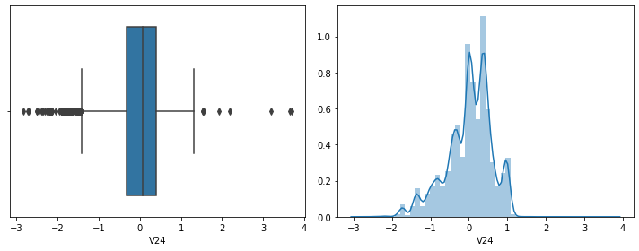
Eda – univariate analysis
In the box plot, it shows that the column V24 is left skewed.
From the distribution plot, we can infer that the distribution of column V24 is not normal.

Slide 11
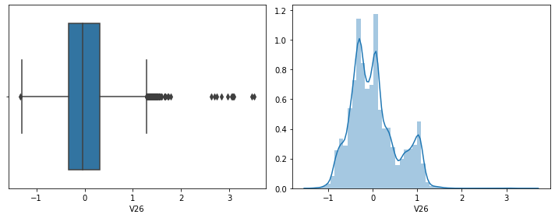
Eda – univariate analysis
In the box plot, it shows that the column V26 is rightly skewed.
In the distribution plot, it shows that the V26 column is not normally distributed.

Slide 12
Eda – univariate analysis
Like the above plots, there are many other columns which are normally distributed but skewed.
COLUMNS | DISTRIBUTION
V3 | Left skewed (normal)
V11 | Right skewed (normal)
V12 | Left skewed (normal)
V14 | Left skewed (normal)
AMOUNT | Right skewed (normal)

Slide 13
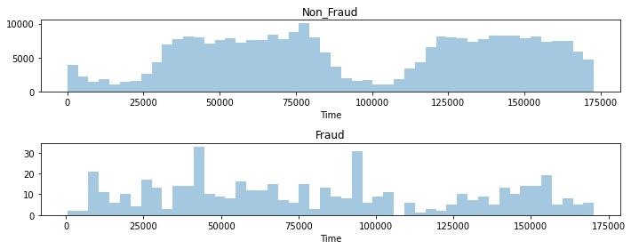
Eda – bivariate analysis
From the above graphs it is clear that non - fraud transactions seem to be normally distributed whereas fraud transactions are not normally distributed.
Also the fraud actions can be seen as high around 45000 and 90000 seconds respectively after the first transaction.

Slide 14
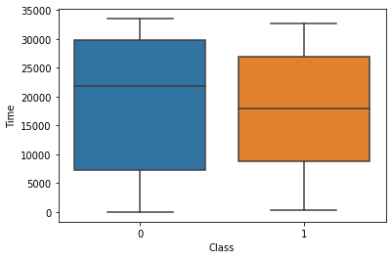
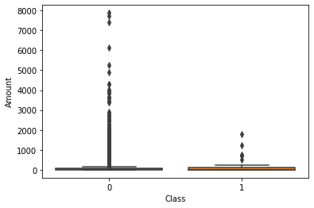
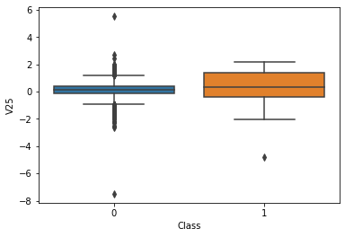
Eda – bivariate analysis
Here, each column is compared with the target variable using a box plot.
From the above images, there were three types of boxplots obtained.
One type of boxplot shows a high interquantile range(IQR or variability) with the medians not overlapping each other like in Time vs. Class.
In the other boxplot we can see the variance is very minimal i.e. low IQR with the medians overlapping each other like in Amount vs. Class.

Slide 15
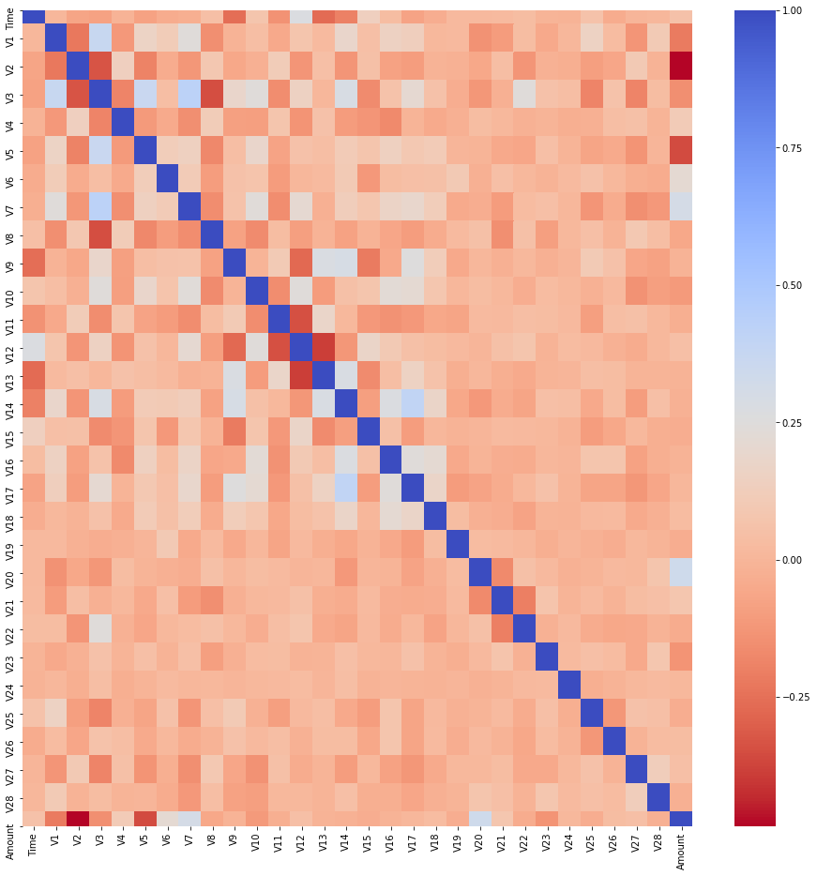
Eda – multivariate analysis
The heat map consists of values of very low correlation, because of the PCA done at the vey beginning reduces the multicollinearity greatly.

Slide 16
Scaling the data
It is a step of Data Pre Processing which is applied to independent variables or features of data.
It is basically helping to normalize the data within a particular range.
In this study we scaled the data by using the Standard scaler function.
Only Time and Amount need to be scaled as others have already undergone PCA.

Slide 17
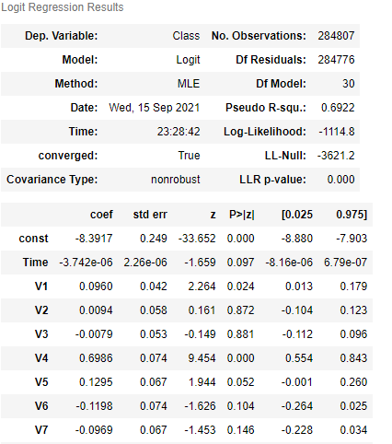
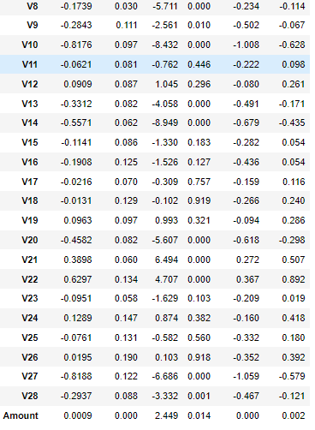
Significant variables
By using the logistic regression, we got the significant variables by comparing with the p-values in the resultant. V1, V4, V5, V8, V9, V10, V20, V21, V22, V27, V28, Amount.

Slide 18
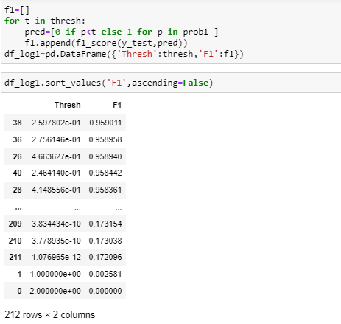
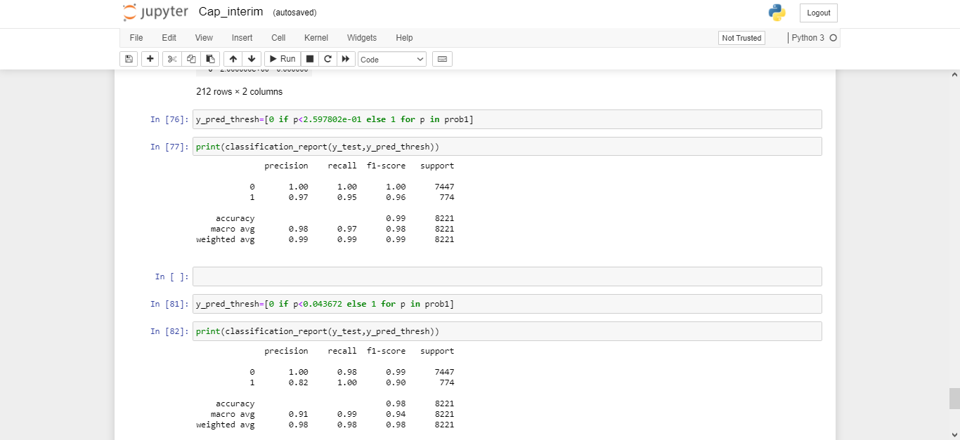
Precision or recall
To handle the high precision or recall, we selected a threshold value by the ROC-Curve and the F1_score.
Then by applying the threshold value, we made a classification report for the model.
Also we also tried using Youden’s index.

Slide 19
EVALUATION Metric - Precision or recall
In this business case scenario Recall is the performance metric required .
As we want to reduce the Type 2 error value(False negatives).
To handle the precision or recall value, we selected a threshold value by the ROC-Curve and the Youden’s index.
The default threshold value (0.5) has a chance of increasing the Type 2 error ,so we opt for a better threshold.

Slide 20
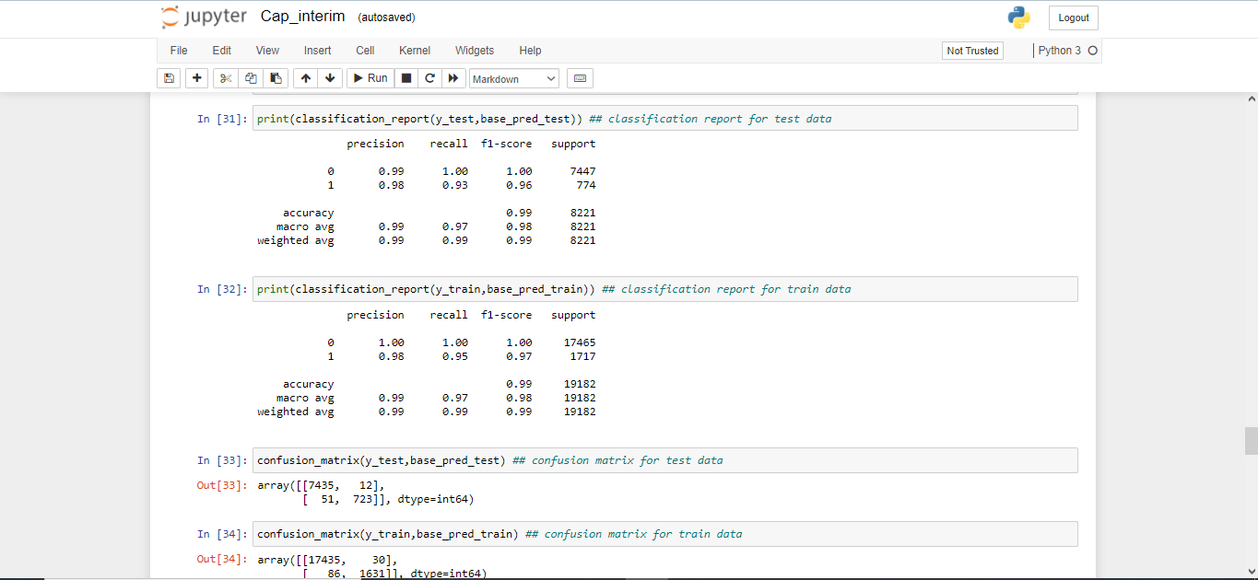
Model building
LOGISTIC REGRESSION MODEL

Slide 21
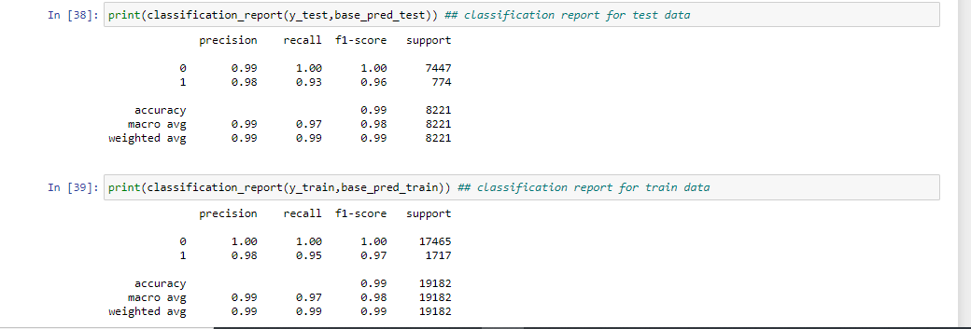
MODEL BUILDING
KNN MODEL

Slide 22
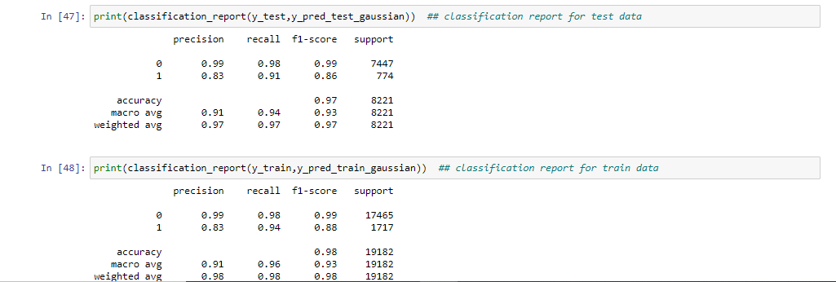
MODEL BUILDING
NAÏVE BAYES MODEL

Slide 23
Conclusion
Further additions to the model:
1.Building the Model after Feature Selection: (Backward elimination,RFE,Forward Selection).
2.Building the Model with other algorithms(Boosting , Bagging algorithms)
to check for overfitting.
3.Deployment of the model.

